Slide 1
Economic Statistics
Dr. Sanda Thein
Professor
Dept. of statistics

Slide 2
Use of National Income statistics as measures of economic growth and living standards
Economic growth occurs when there is a rise in the value of Gross Domestic Product (GDP).
GDP measures the quantity of goods and services produced in an economy.
A rise in economic growth means there has been an increase in national output.
Economic growth leads to higher living standards and more employment opportunities.
Real GDP is the value of GDP adjusted for inflation.
eg, if the economy grew by 4% since last year, but inflation was 2%, real economic growth was 2%.

Slide 3
Use of National Income statistics as measures of economic growth and living standards
Nominal GDP is the value of GDP without being adjusted for inflation.
In the above example, nominal economic growth is 4%. This is misleading, because it can make GDP appear higher than it really is.
Total GDP is the combined monetary value of all goods and services produced within a country’s borders during a specific time period.
GDP per capita is the value of total GDP divided by the population of the country. It essentially measures the average output per person in an economy. This is useful for comparing the relative performance of countries.

Slide 4
National income can also be measured by:
Gross National Product (GNP) is the market value of all products produced in an annum by the labour and property supplied by the citizens of one country.
It includes GDP plus income earned from overseas assets minus income earned by overseas residents.
GDP is within a country’s borders, while GNP includes products produced by citizens of a country, whether inside the border or not.

Slide 5
National income can also be measured by:
Gross National Income (GNI) is the sum of value added by all producers who reside in a nation, plus product taxes (subtract subsidies) not included in the value of output, plus receipts of primary income from abroad (this is the compensation of employees and property income).

Slide 6
The use and limitations of national income data to compare differences in living standards between countries
GDP does not give any indication of the distribution of income.
two countries with similar GDPs per capita may have different distributions which lead to different living standards in the country.
GDP may need to be recalculated in terms of purchasing power, so that it can account for international price differences.

Slide 7
The use and limitations of national income data to compare differences in living standards between countries
The purchasing power is determined by the cost of living in each country, and the inflation rate.
There are also large hidden economies, such as the black market, which are not accounted for in GDP. This can make GDP comparisons misleading and difficult to compare.

Slide 8
The importance of using purchasing power parity (PPP) exchange rates when making international comparisons of living standards
This is a theory that estimates how much the exchange rate needs adjusting so that an exchange between countries is equivalent, according to each currency’s purchasing power.
For example, if a car cost £15,000 and the exchange rate between the UK and the US is 1.5 £ per $, then in the US, the car should cost $10,000.
This means both cars cost the same number of US dollars, and the same number of pounds Sterling. This helps to minimise misleading comparisons between countries.

Slide 9
National debt (government or public sector debt)
The national debt is the amount of money the government has borrowed at one time through issuing securities by the Treasury.
The national debt is the accumulation of the government deficit over time. It is the total amount the government owes.

Slide 10
Factors influencing the size of national debts
If the government is continuously running a deficit, the size of the debt increases. If the government reduces the size of their deficit, the rate of increase of the total debt is slower, but the debt is still increasing.
It is only when the government runs a budget surplus that the size of the national debt decreases.

Slide 11
The significance of the size of national debts
The cost of borrowing could increase, since by borrowing money, the government is increasing demand for credit in the economy.
If confidence is lost in the government’s ability to repay the debt, governments might have to raise interest rates to encourage investors to buy bonds, so that they can finance the debt.
It could lead to higher taxes and austerity measures, especially if the debt becomes uncontrollable.

Slide 12
The significance of the size of national debts
More government spending could lead to crowding out of the private sector.
This leaves fewer funds in the private sector for firms to use, since the government is borrowing money, which crowds them out of the market.

Slide 13
WHAT IS THE SYSTEM OF NATIONAL ACCOUNTS?
The system of national accounts (SNA) is a comprehensive, accounting framework within which economic data can be presented on the operation of the nation’s economy.
It is an integrated set of economic accounts, balance sheets and other tables describing all economic flows and stocks taking place within a country.
It is based on a set of internationally agreed concepts, definitions, classifications and accounting rules.

Slide 14
WHAT ARE NATIONAL ACCOUNTS STATISTICS USED FOR?
WHAT ARE NATIONAL ACCOUNTS STATISTICS USED FOR?
1. Monitoring the economy
2. Economic policy making
3. International comparison
4. Forecasting and simulation
5. Market research

Slide 15
LINKS TO BUSINESS ACCOUNTING
National accounts to a large extent is an adaptation of business accounting practices to the measurement of economic variables.
1. Based on a double entry system of accounting
2. Each account is a balancing statement– total uses (debits) on the left hand side equal total resources (credits) on the other side.
3. Each entry in one account says that the payer must have an opposite and equal contra-entry in the account of the receiver.

Slide 16
The System of National Accounts
Differences:
1. With respect to national accounting all parties to the transactions are shown, whereas in business accounting the books are kept from the point of view of the individual firm.
2. The national accounting entries are compiled from statistical data according to useful economic concepts and definitions, which do not necessarily correspond to those employed in business accounting. Caption describing picture or graphic.
3. Some information in the national accounts are presented in matrix form when looking at supply and use and input output tables.

Slide 17
THE ACCOUNTS IN THE SNA
Current accounts: record production of goods and services, income generation and distribution and income used for consumption and saving
Accumulation accounts: record acquisition and disposal of financial and non-financial assets and liabilities and changes in net worth
Balance sheets: show the value of the stock of assets and liabilities at the beginning and end of an accounting period

Slide 18
MEASUREMENT OF PRODUCTION
One very important aspect of the national accounting system is the measurement of production.
This is the process whereby labour, materials and assets are used to transform inputs of goods and services into outputs of other goods and services.
The SNA defines what constitutes production - the production boundary.

Slide 19
CONCEPT OF PRODUCTION BOUNDARY
In the system of national accounts the production boundary includes:
1. Production of all goods whether produced for the market, for own consumption or for capital formation
2. Production of services if: Sold on the market Supplied to units other than the producer
3. Production of own account housing services
4. Illegal and concealed production

Slide 20
Household activities included in the production boundary
• Services provided by paid domestic staff
• Major do-it-yourself repair and maintenance of durable goods used in production (fixed capital) and dwellings (own account capital formation)
• Agricultural production, storage and processing

Slide 21
Household activities excluded from the production boundary
• Domestic services produced and consumed by the same households without paying domestic staff
• Minor do-it-yourself repair and maintenance of durable goods and dwellings

Slide 22
GROSS DOMESTIC PRODUCT (GDP)
GDP is the cornerstone of the national accounting system.
It is the total unduplicated value of all goods and services produced in a country during a given period.
It is the single, most widely used indicator of economic performance.

Slide 23
MEASUREMENT OF GDP
There are three ways to measure GDP:
Income approach - sum of wages and salaries, profits generated in production, consumption of fixed capital and taxes on production and imports less subsidies on production and imports .

Slide 24
MEASUREMENT OF GDP
Expenditure approach - sum of household spending, government spending on goods and services, investment in fixed capital (construction, machinery and equipment), change in inventory and exports less imports of goods and services.
Production approach - summing the value added of all industries.
The value added of an industry is equal to its gross output (mainly its sales) less its purchases from other industries (intermediate consumption).

Slide 25
Gross Output - comprises those goods or services that are produced within an establishment that become available for use outside that establishment.
It includes inventories of work-in-progress and finished goods.
Output can either be valued at basic or producers’ prices.

Slide 26
Intermediate Consumption - consists of the value of the goods and services that are used as inputs in the production process.
These may either be transformed or used up by the production process. It also includes the value of all goods or services that support the production process e.g. accounting and data processing.

Slide 27
VALUE CONCEPTS FOR GDP
Value added for an industry is valued at basic prices. It is equal to:
Output at basic prices less Intermediate consumption at purchasers’ prices GDP for the economy is valued at market prices.
Sum of value added of all industries plus Taxes on products less Subsidies on products

Slide 28
RELATIONSHIP BETWEEN BASIC, PRODUCERS’ AND PURCHASERS’ PRICE
Basic price is the amount received by the producer less tax payable plus subsidies receivable.
Producers’ price is the basic price plus tax payable (except VAT) less subsidies receivable.
Purchasers’ price is the amount paid by the purchaser excluding deductible VAT.
It includes transport charges paid separately by the purchaser.

Slide 29
Basic prices plus Taxes on products (except GCT) less Subsidies on products
equals Producers’ prices plus Trade & Transport margins plus GCT
• equals Purchasers’ prices

Slide 30
GROSS DOMESTIC PRODUCT AT CONSTANT PRICES
Change in the Gross Domestic Product is a result of:
change in the quantity of goods and services produced and
change in the price at which the goods and services are sold

Slide 31
GDP at current prices measures both changes as production is valued at prices of the given period.
On the other hand, GDP at constant prices measures the quantity change as production is valued at base year prices.
The rate of change from period to period provides an indication of economic performance as it eliminates the price effect and only shows the change in volume of goods and services produced.

Slide 32
NATIONAL ACCOUNTS MAIN AGGREGATES
GDP Production approach
GDP at market prices =
Sum of values added at basic prices + Taxes on products
- Subsidies on products

Slide 33
GDP Expenditure approach
GDP at market prices =
Private final consumption expenditure
+ Government final consumption expenditure
+ Gross fixed capital formation
+ Changes in inventories
+ Exports of goods and services
- Imports of goods and services

Slide 34
GDP Income approach
GDP at market prices =
Compensation of employees
+ Taxes on production and imports
- Subsidies on production and imports
+ Operating surplus/ mixed income
+ Consumption of fixed capital

Slide 35
National Income
Net national income =
GDP at market prices
+ Primary incomes receivable from the rest of the world
- Primary incomes payable to the rest of the world
= Gross national income (GNI) at market prices - Consumption of fixed capital

Slide 36
National disposable income
Net national disposable income =
Gross national income at market prices
+ Current transfers receivable from the rest of the world
- Current transfers payable to the rest of the world
= Gross national disposable income - Consumption of fixed capital National saving National saving

Slide 37
National saving
National saving =
Net National disposable income
- Final consumption expenditure

Slide 38
CLASSIFICATION OF INDUSTRIES USED
SYSTEM OF NATIONAL ACCOUNTS
Agriculture, Forestry & Fishing - Mining & Quarrying
Manufacture - Electricity & Water
Construction - Hotels & Restaurants
Transport, Storage & Communication - Finance & Insurance Services
Other Services - Wholesale & Retail Trade; Repairs & Installation of Machinery
Real Estate, Renting & Business Activities - Producers of Government Services

Slide 39
Consumer Price Index
is also known as cost of living index.
It is usually a month price index computed for a predetermined list of commodities called basket.
Since the weight or quantity used in the construction of the C.P.I can also be available from the data of consumer expenditure surveys, the most suitable formula to calculate CPI is the Laspeyre’s one.

Slide 40
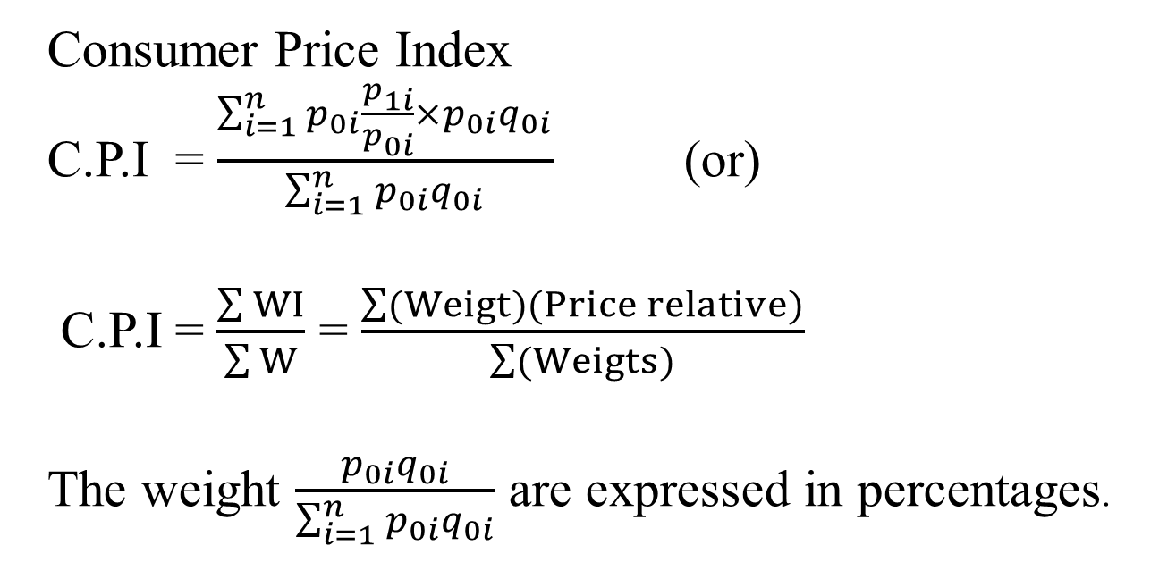
Consumer Price Index
Consumer Price Index
C.P.I = $\frac{\sum_{i=1}^{n}{p_{0i}\frac{p_{1i}}{p_{0i}}×p_{0i}q_{0i}}}{\sum_{i=1}^{n}{p_{0i}q_{0i}}}$ (or)
C.P.I = $\frac{\sum{WI}}{\sum{W}}$ = $\frac{\sum{(Weigt)(Price relative)}}{\sum{(Weigts)}}$
The weight $\frac{p_{0i}q_{0i}}{\sum_{i=1}^{n}{p_{0i}q_{0i}}}$ are expressed in percentages.

Slide 41
Group | Weight | Price Relative Oct 2020 (Jan, 2017=100)
Food | 158 | 120.4
Cutering | 47 | 130
Alcohol | 77 | 128.2
Tobacco | 34 | 116.5
Housing | 185 | 172
Fuel and Light | 50 | 121.9
Household good | 71 | 117.2
Household Services | 40 | 123.2
Clothing and Factor Ware | 69 | 117.6
Personal goods and services | 39 | 125.6
Motoring Expenditure | 131 | 127.5
Fares and Others | 21 | 126
Leisure Goods | 48 | 114.2
Leisure Services | 30 | 128.4

Slide 42
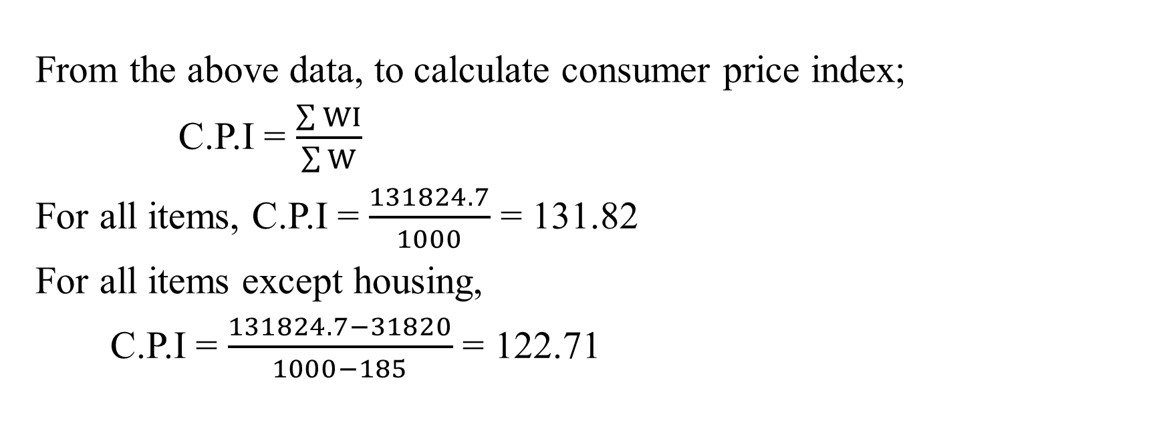
From the above data, to calculate consumer price index;
C.P.I = $\frac{\sum{WI}}{\sum{W}}$
For all items, C.P.I = $\frac{131824.7}{1000}$ = 131.82
For all items except housing,
C.P.I = $\frac{131824.7−31820}{1000−185}$ = 122.71

Slide 43
Comment
The index of consumer price for Oct 2020 with (Jun 2017 = 100) is 131.82 (increased by 31.82% compare with base year 2017).
The index of consumer price except housing for Oct 2020 with (Jun 2017 = 100) is 122.71 (increased by 22.71% compare with base year 2017).

Slide 44

Rate of Inflation
The rate of inflation is the percentage increase in price over a period usually over one year. This is usually expressed as an annual rate.
Rate of inflation = $\frac{current year CPI−Base Year CPI }{Base Year CPI}×100$
Real Average Salary/Wages = $\frac{current salary/wages }{consumer price index}× 100$

Slide 45

Example,
To calculate the rate of inflation for 2015 by using the following index,
Rate of Inflation = $\frac{current year C.P.I−Base year C.P.I}{Base year C.P.I}×100$
Year | Index of Retail Prices (2012=100)
2012 | 100
2013 | 101.9
2014 | 106.9
2015 | 115.2
2016 | 126.7

Slide 46

To find the rate of inflation in 2015, we take the increase from 2014,
Rate of Inflation = $\frac{115.2−106.9}{106.9}×100$
= 7.8%
Therefore, the rate of inflation for 2015 is 7.8%, i.e. the consumer price index is increased by 7.8% compare with last year (2014) within a one year.

Slide 47

Terms of Trade:
The term of trade for a country is the rate at which a country exchanges its exports for imports, changes in terms of trade can be measured by the average prices of exports.
Changes in terms of trade can be measured by the average prices of exports and the average prices of imports. It can also be defined as the ratio of export prices to imports prices.
The formula to calculate an economy's TOT is:
Terms of trade (TOT) =$\frac{Index of Exporter Price}{Inded of Importer Price}$×100
Terms of trade (TOT) $=\frac{P_{E}}{P_{I}}$×100

Slide 48
If the country's export is cheap relative to its imports, then more goods would have to the exported by the country in order purchase given quantity of imports. Terms of trade is said to worsen or become unfavorable.
Conversely, if the export price increases relative to its imports price, terms of trade is said to have improved because the country would be able to purchase a given quantity of export.

Slide 49

Example State whether the following changes will bring about a favorable or unfavorable terms of trade.
$P_{E}$= price of export $P_{I}=price of import$
$P_{E}$> $P_{I}$ = favorable $P_{E}<$ $P_{I}$ = unfavorable
1. $P_{E}$increases while $P_{1}$decrease.
2. Increases $P_{E}$ases in $P_{E}$ are greater than increases $P_{I}$
3. The increases in $P_{E}$less than the increases in $P_{I}$
4. $P_{E}$remains constant while $P_{I} decreases.$
5. $P_{E}$increase while $P_{I}$ remain constant.
6. $P_{E} remain$ constant while $P_{I} increases$
7. $P_{E}$decreases while $P_{I}$increases
8. Terms of trade = 110
9. Terms of trade = 98
10.Terms of trade =100

Slide 50
What Is Balance of Trade?
The balance of trade (BOT) is defined as the difference between the value of exports and the value of imports of a country. The figure that is derived shows how economically stable a nation is. It is one of the significant components of any economy’s current asset as it measures a country’s net income earned on global investments.
There are two types of balance of trade – favorable/positive trade balance or trade surplus, and unfavorable/negative trade balance or trade deficit.

Slide 51
Favorable/Positive Trade Balance
The balance of trade is positive and favorable when an economy’s exports are more than its imports.
Unfavorable/ NegativeTrade Balance
This is the situation that arises when a country imports more than it exports. Also termed as trade deficits , such situations lead to an unfavorable trade balance for a country.
Formula
The balance of trade formula is as follows:
Balance of Trade = Country’s Exports – Country’s Imports.

